Slide 1


ESL²
The Elements of Statistical Learning
Sculpturing the Feature Space
Michal Kováč
Laboratories Brainworks
Faculty of Informatics and Information Technologies STU

Slide 2

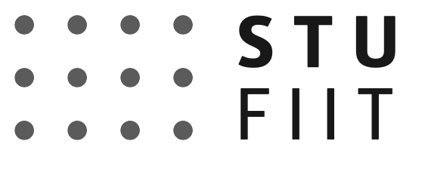
: Overview
ISL Book Chapters: | None for this module.
Synopsis: | Second module of the ESL course explores standard processes how large data can be distilled into a small number of well-designed features suitable for statistical learning. Unlike general machine learning, statistical learning relies on both predictors (features) and target variables to meet specific criteria. This process, known as requirement analysis, forms the core of learning material of this module.
Competencies: | Learn how to transform raw, high-dimensional data into concise, informative features tailored for statistical learning models. Understand what tidy data means. Develop the ability to assess whether predictors and target variables meet the assumptions of specific statistical learning techniques.
Prerequisites: | Understanding of probability and statistics is needed at the basic level. Further, limited working proficiency in Tidyverse dialect of R programming language is needed to complete practical exercises.
Tutorials:
Data: | FIFA22 dataset from Kaggle (https://www.kaggle.com/datasets/stefanoleone992/fifa-22-complete-player-dataset)

Slide 3
Quote of the Day
To understand what AI can do for you requires understanding what AI needs to get things done.
Unknown shady character.

Slide 4

Chinese Bronze Bell
Birth of probabilistic thinking and normal distribution.
500 - 300 BC

Slide 5
Before talking about ML, we should talk about data…
The shape of the Chinese bronze bell elegantly mirrors the Gaussian distribution, with its balanced symmetry and central peak.
This iconic form serves as a powerful analogy for statistical learning, where normally distributed predictor data provides a natural foundation for many modeling techniques.

Slide 6
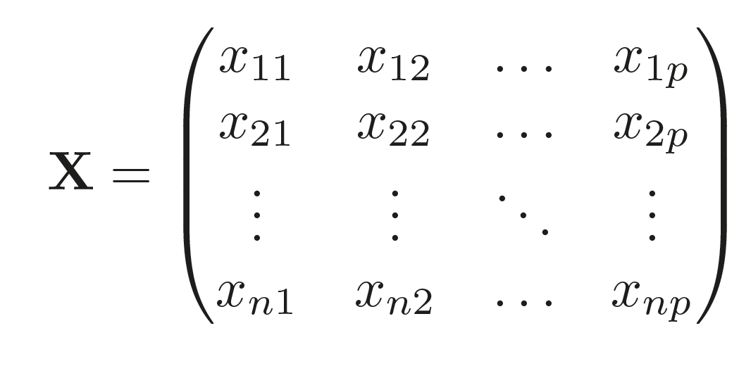
Data Table
Attributes or Features (age, gender, year …)
Feature value
Data point
Observations
(patient 1
patient 2
… )
n data points
Feature
p variables

Slide 7
 | Context | Meaning | Example
Attribute | Databases, descriptive modeling | A property or characteristic of an entity, often categorical or descriptive. | In a patient record: blood type, gender, age group.
Variable | Statistics, mathematics | A measurable quantity that can take different values. Broad umbrella term. | 𝑋 = systolic blood pressure, 𝑌 = cholesterol level.
Predictor | Regression, supervised learning | A variable used specifically to explain or predict an outcome (dependent variable). | In cancer risk modeling: smoking status, genetic mutation presence.
Feature | Machine learning, AI | A representation of data used by algorithms. Can be raw variables or engineered transformations. | Word embeddings, principal components, normalized BMI.

Slide 8

Describing Datasets
Attributes
Attributes
Billy Suzy Jenny
Quiz1 Test1 Quiz2
NA
F
A
Quiz 1
NA
D
C
Billy
n data points
n data points
D
NA
A
Test 1
F
NA
NA
Suzy
Observations
Observations
C
NA
B
Quiz 2
A
A
B
Jenny
p variables
p variables
The data is the same, but the layout is different. Our vocabulary of rows and columns is simply not rich enough to describe why the two tables represent the same data. But we can easily see why they are not suitable for statistical learning.

Slide 9
Tidy Data Semantics
A dataset is a structured collection of values, which may be numbers (quantitative) or strings (qualitative). These values are organized along two dimensions:
Variables or Features: Each variable gathers all values that represent the same underlying attribute (such as height, temperature, or duration) across different units.
Observations: Each observation brings together all values recorded for a single unit (such as a person, a day, or a race) across multiple attributes.
In other words, every value in a dataset belongs simultaneously to a variable/feature and to an observation.

Slide 10
Tidying Messy Datasets
Column headers are values, not variable names.
Variables are stored in both rows and columns.
Attributes
Billy Suzy Jenny
NA
F
A
Quiz 1
n data points
D
NA
A
Test 1
Observations
C
NA
B
Quiz 2
p variables

Slide 11
Tidy Data
Attributes
Every cell is a single value
Name Assessment Grade
Every row is an observation
Billy
Quiz 1
NA
Observation 1
n data points
Billy
Test 1
D
Observation 2
Billy
Quiz 2
C
Observation 3
Observations
Suzy
Quiz 1
F
Observation 4
Suzy
Test 1
NA
Observation 5
Suzy
Quiz 2
NA
Observation 6
Every column is a variable
p variables

Slide 12
Common Data Problems
Real datasets can violate the three precepts of tidy data in almost every way imaginable. While occasionally you do get a dataset that you can start analysing immediately, this is the exception, not the rule.
This list describes the five most common problems with messy datasets:
Column headers are values, not variable names.
Multiple variables are stored in one column.
Variables are stored in both rows and columns.
Multiple types of observational units are stored in the same table.
A single observational unit is stored in multiple tables.
Surprisingly, most messy datasets can be tidied with a small set of tools: pivoting and separating.
Notes:
Explore https://cran.r-project.org/web/packages/tidyverse/index.html

Slide 13
 | Tidy Data | Common Data
Structure | Each variable = column, each observation = row, each value = single cell. | Variables may be spread across multiple columns, combined, or nested; observations may be split or aggregated.
Ease of Modeling | Directly compatible with ML algorithms (predictors and outcomes clearly separated). | Requires reshaping, pivoting, or manual extraction before modeling.
Feature Engineering | Straightforward: transformations (scaling, encoding, polynomial terms) apply cleanly to columns. | Complicated: features may need to be disentangled from merged or duplicated columns.
Interpretability | Clear mapping between variables and attributes → easier to explain model inputs/outputs. | Ambiguous variable definitions → harder to trace predictors back to real-world attributes.
Visualization | Works seamlessly with libraries like seaborn, ggplot2, matplotlib. | Often requires restructuring before plotting meaningful relationships.
Reproducibility | Analyses are portable and consistent across tools and teams. | High risk of errors due to ad‑hoc reshaping; harder to replicate workflows.
Scalability | Scales well to large datasets; pipelines can be automated. | Scaling is inefficient; preprocessing steps multiply with dataset size.

Slide 14
Once data are secured, finding suitable features is like…
is like sculpting from a block of marble; the raw material is abundant, but only careful chiseling reveals the form that truly matters. Each feature must be examined, shaped, or discarded to uncover the structure that best supports the learning goal, balancing elegance, relevance, and statistical integrity.

Slide 15

Feature 1
Feature 2
$\hat{f}$
Observations/values
(patient 1
patient 2
… )
n data points
Finding Relationships
Predictor variable
(Feature)
p variables
Dependent variable
(Feature)
Feature space

Slide 16
Choose Modeling Method
Hybrid
Learning Goal Clarification e.g. prediction, classification, clustering, inference
Define outcome to be modeled
12
Validate Assumptions
Parametric
12
Select Features
Approx. number of method families
25
e.g. co-linearity, normality, etc.
Identify relevant independent variables
Non-parametric
15
Semi-parametric

Slide 17
Statistical Assumptions
 |  | Linear Regression | Polynomial Regression | Poisson Regression
Target Variable |  | Continuous | Continuous | Continuous
Predictor Variable | Independence | Observations should be independent | Observations should be independent | Observations should be independent
 | Normality | Not required | Not required | Not required
 | Collinearity | No severe multicolinearity | No severe multicolinearity | No severe multicolinearity
 | Feature Scaling | Not required | Not required | Not required
Outliers |  | No extreme outliers | No extreme outliers | No extreme outliers
Homoscedasticity |  | Required | Required | Required
Sample Size |  | Large sample size is recommended | Large sample size is recommended | Large sample size is recommended

Slide 18
Statistical Assumptions
 |  | Logistic Regression | LDA/QDA | Support Vector Machines
Target Variable |  | Binary | Binary of multiclass | Binary of multiclass
Predictor Variable | Independence | Observations should be independent | Observations should be independent | Observations should be independent
 | Normality | Not required | Required | Not required
 | Collinearity | No severe multicolinearity | No severe multicolinearity | No severe multicolinearity
 | Feature Scaling | Not required | Required: features should have the same variance and mean | Required for optimal performance
Outliers |  | No extreme outliers | No extreme outliers | Sensitive to outliers
Homoscedasticity |  | Not required | Not required | Not required
Sample Size |  | Large sample size is recommended | Large sample size is recommended | Performs well with smaller data

Slide 19
Feature selection in statistical learning is to EDA like…
pre-flight checks before launching a plane: EDA is like checking the weather and fuel. Feature selection via requirement analysis is like checking the aircraft, flight plan, airspace clearance, and mission objective. Statistical learning methods often require careful EDA, whist methods from machine learning realm necessarily do not.

Slide 20
Filter Methods
Wrapper Methods
Embedded Methods
Domain-Guided Methods
Model-agnostic
Model-dependent
Model-integrated
Context-dependent
r²
Forward Selection
Mechanical Turk
1
Correlation
LASSO
2
1
2
Mutual Information
Backward Elimination
Elastic Net
Decision Rules
ANOVA F-Test
Stepwise selection
Decision Tree Importance
Variance Threshold
Gradient Boosting Importance
Kolmogorov-Smirnov Test
RFE

Slide 21
 | Purpose | Methods | Strengths
Filter Methods | Evaluate features independently of the model | Correlation, coefficient of determination, mutual information, Chi-squared, F-test, variance threshold | Fast, interpretable, good for pre-processing
Wrapper Methods | Use model performance to guide selection | Forward selection, backward elimination, stepwise selection | Captures interactions tailored to the model
Embedded Methods | Integrate feature selection into model training | LASSO, Elastic net, decision tree importance, recursive feature elimination | Efficient, often yields sparse interpretable models
Domain-guided Methods | Apply expert knowledge or constrains | Manual curation, rule-based inclusion/exclusion, clinical relevance filters | Ensures trust, interpretability, ethical alignment

Slide 22
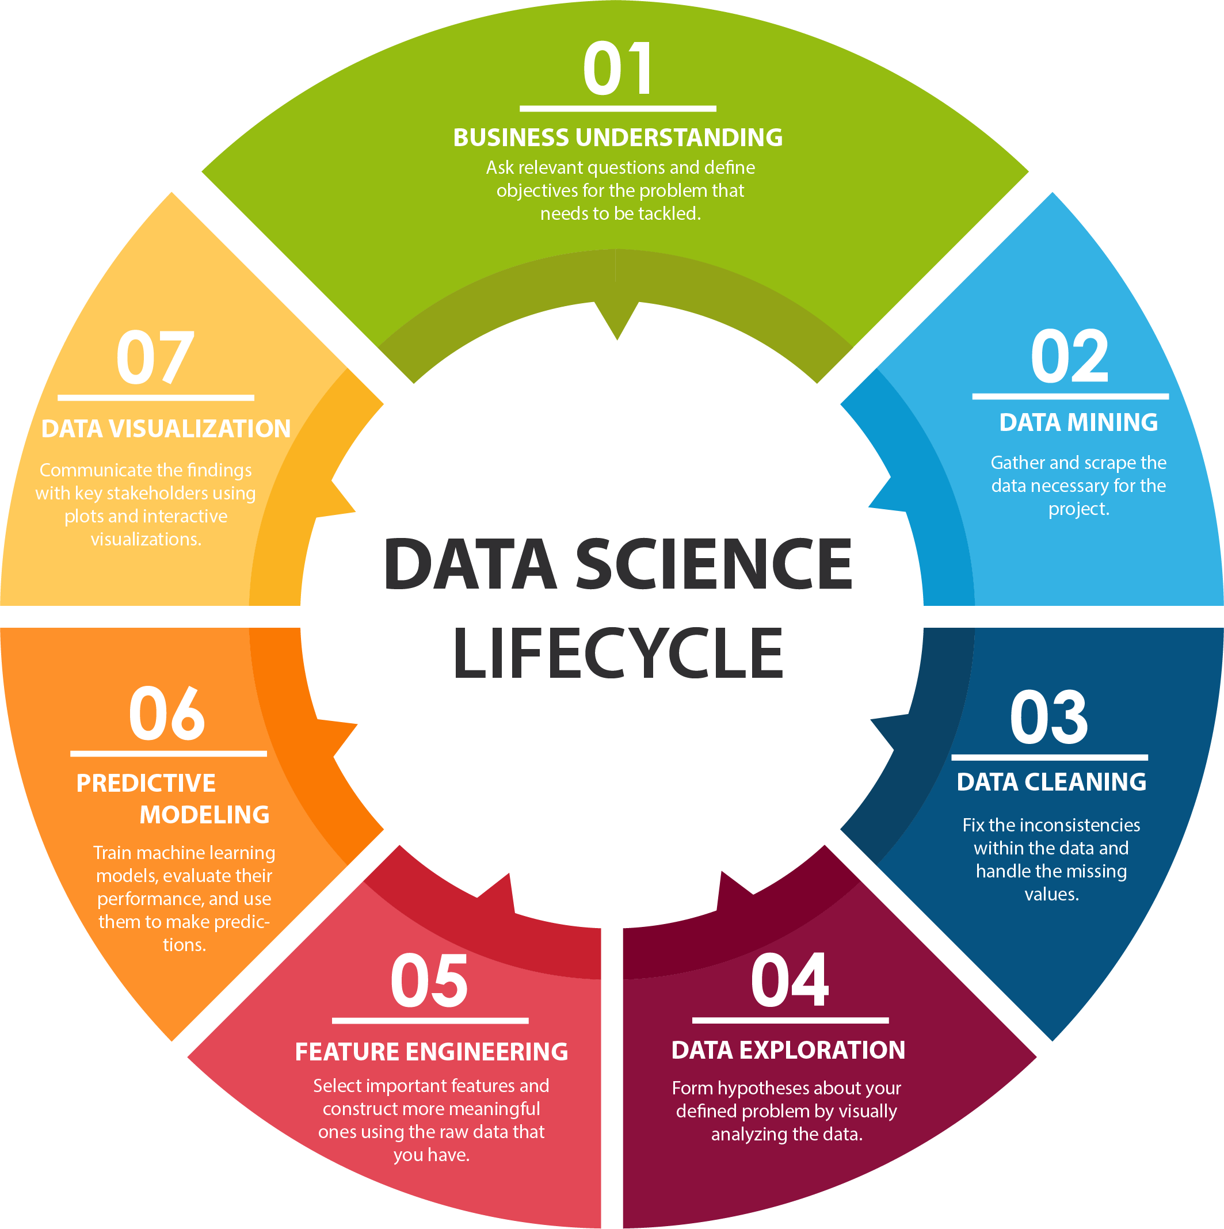

Slide 23

Define the learning task (regression, classification, etc.); clarify assumptions and constraints
Communicate model diagnostics (residuals, feature importance, partial dependence).
Visualize feature impact, selection rationale, and model fit to support stakeholder decisions.
Check if features are available, relevant and measurable. Anticipate encoding needs.

Slide 24

Assess feature stability, impute or drop based on impact; enforce tidy structure.
Prepare data for modelling: handle missing values, outliers, and inconsistencies.
Choose a machine learning model after feature selection guided by EDA.
If needed, apply regularization, dimensionality reduction (PCA), or embedded feature selection (e.g., LASSO).
Select features based on your needs and data.
Select informative features using domain knowledge, correlation, and algorithmic means, etc.

Slide 25
 | Statistical Learning | Machine Learning
Data Quality Assessment | Ensures assumptions (e.g. independence, normality) are not violated | Variables may be spread across multiple columns, combined, or nested; observations may be split or aggregated
Variable Understanding | Assess distributions, transformation (e.g. log), and linearity for parametric models | Guides encoding, scaling and feature selection for non-parametric models
Target Variable Profiling | Validates outcome types (continuous, binary, count) for model choices | Informs loss function and architecture
Feature Relevance | Supports manual selection based on domain knowledge and correlation analysis | Enables automatic selection via importance scores, mutual information or embeddings
Assumption Checking | Tests linearity, homoscedasticity, independence and multicolinearity | Focuses on overfitting, bias-variance trade-off
Selection Guidance | Suggests interpretable models (e.g. GLM, Cox models) based on data structure | Suggests flexible models (e.g. trees, ensembles, neural nets) based on complexity
Visualization for Stakeholders | Communicate statistical relationships and diagnostics (e.g. residual plots) | Communicate feature impact and prediction behavior (e.g. SHAP, partial dependence)

Slide 26
EDA for model agnostic methods…
means examining the dataset in a way that does not depend on any specific predictive model. Instead of fitting a classifier or regressor first, you explore the raw variables and their relationships to the target to decide which features may be useful.
In practice, this involves visualizing distributions, checking correlations, and computing statistical scores such as mutual information, chi-squared tests, or ANOVA. These steps help you understand which variables carry signal versus noise.
It is important because model-agnostic EDA provides a neutral foundation for feature selection: you can identify redundant, irrelevant, or highly informative features before committing to a particular algorithm.

Slide 27
A Grammar of Data Manipulation
The grammar of data manipulation is the idea that working with data follows a consistent set of rules, much like language.
This makes data workflows in statistical learning predictable and expressive: you can “write” pipelines that read like sentences, where each verb transforms the dataset in a clear and reproducible way.
T
Tutorials: | 3.3 A Grammar of Data Manipulation 3.4 Summarizing Data 3.5 Data Tidying (Intermediate)

Slide 28
A Grammar of Graphics
The Grammar of Graphics is a language for visualization during EDA, giving us rules and components to construct any chart, rather than relying on predefined plot types.
Instead of simply instructing “make a scatterplot” or “make a bar chart,” the Grammar of Graphics breaks visualizations into fundamental building blocks.
T
Tutorials: | 5.1 A Layered Grammar of Graphics 5.2 Visualizing Distributions and Relations

Slide 29

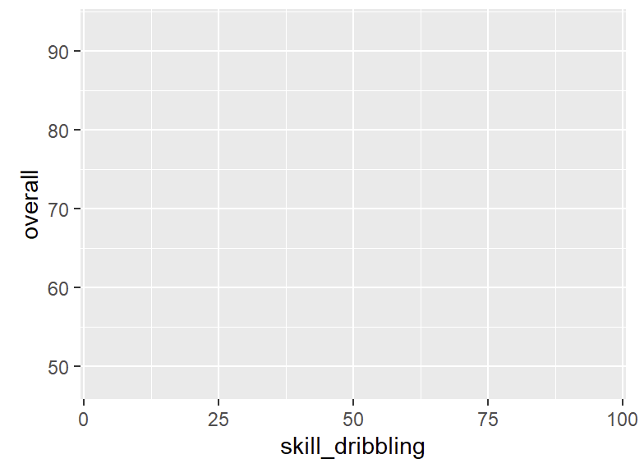
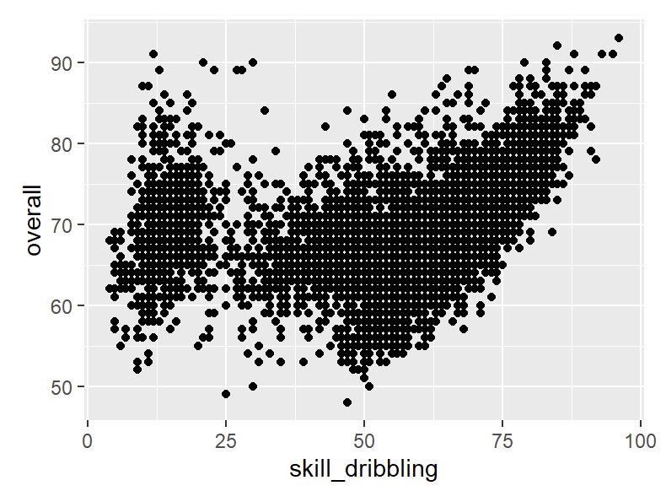
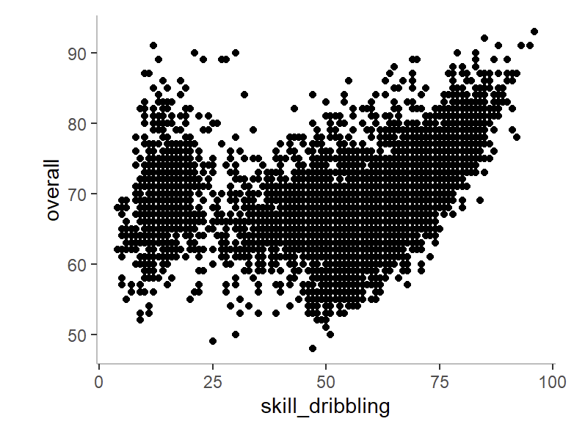
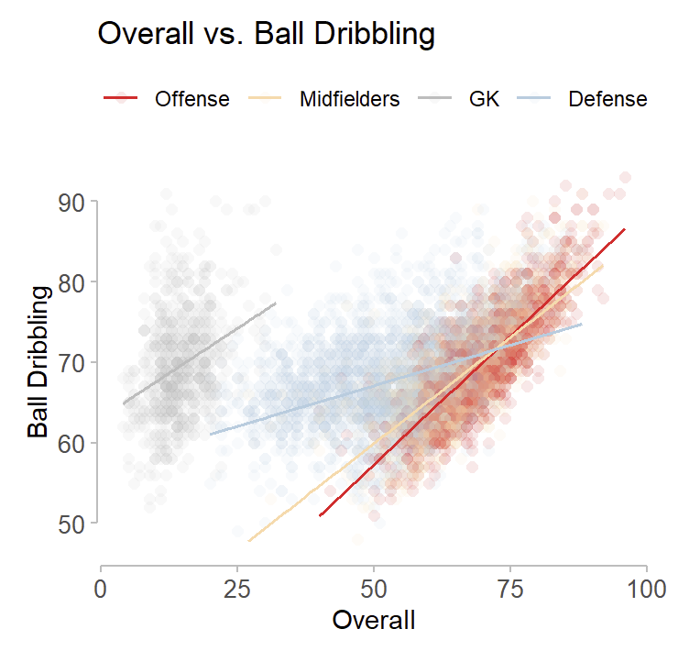
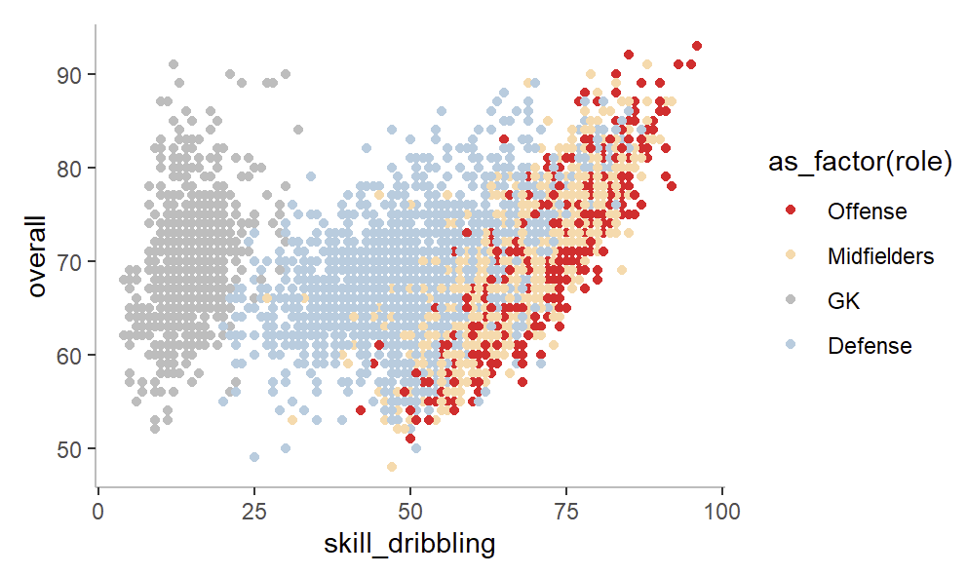
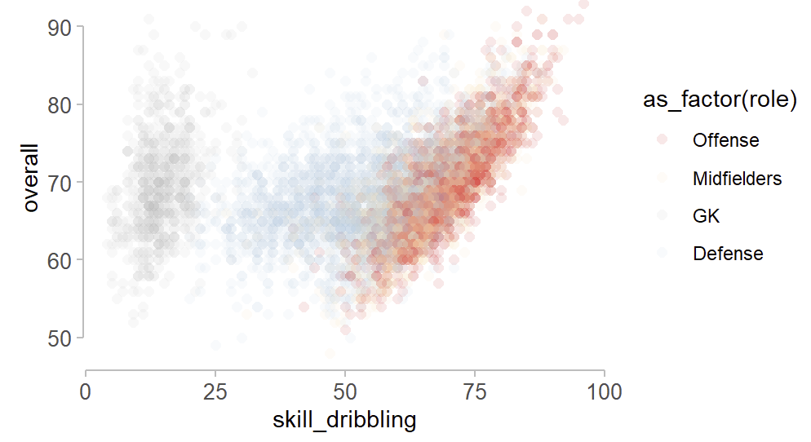
The shape used (points, lines, bars…)
Geoms
Empty canvas: Space for dataset which is not yet defined
Variables: Mappings of data to visual dimensions
T
How values map to aesthetics (linear, log, categorical…)
Aesthetics
Scales
Visual attributes (color, size, shape…)
Stats
Transformations or summaries (counts, function, smoothers…)
Coordinates
The space used
(Cartesian, polar)

Slide 30
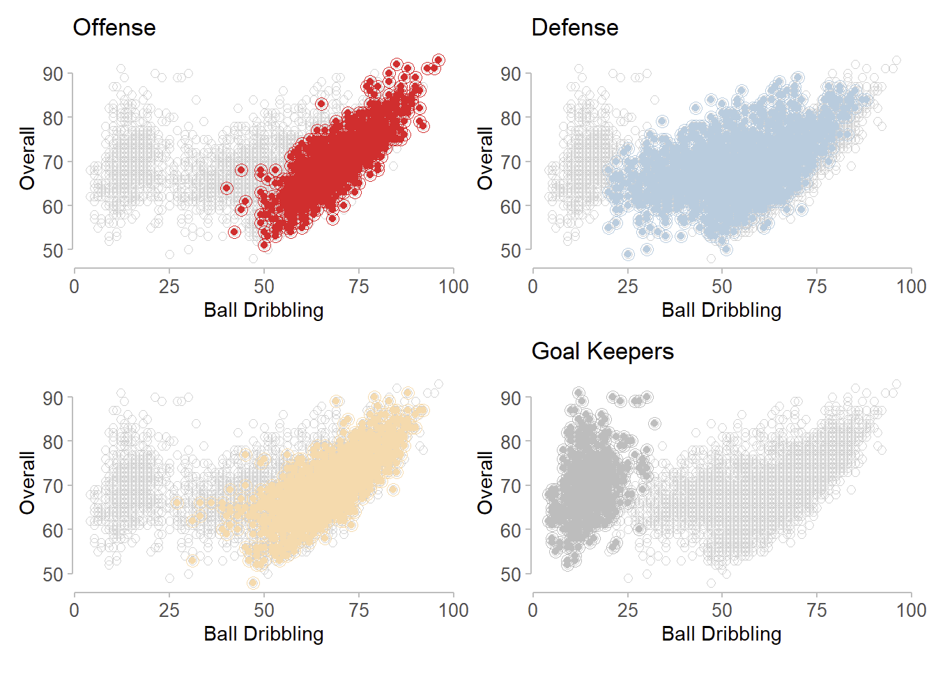
Facets
Splitting data into subplots Combining visual and table data in one canvas
T

Slide 31
: Take-Home Message
The Principles of Tidy Data: | A standardized way of organizing datasets where each variable is a column, each observation is a row, and each type of observation is a table. Ensures consistency, makes preprocessing easier, and allows statistical tools and ML pipelines to work seamlessly.
A Grammar of Data Manipulation: | Grammar of data manipulation ensures experimental reproducibility in data science. Think of it as the grammar of cooking: select ingredients, filter what’s fresh, arrange them, transform with heat, summarize into a dish, and sometimes join with side dishes. The rules are consistent, so anyone following them can reproduce the recipe.
Feature Selection: | The process of identifying the most relevant variables for modeling, using methods like filters (correlation, ANOVA), wrappers (RFE), or embedded approaches (LASSO, tree importance). Reduces dimensionality, improves interpretability, prevents overfitting, and speeds up training.
Exploratory Data Analysis: | Exploratory Data Analysis (EDA) is the process of examining and summarizing datasets to uncover patterns, spot anomalies, test assumptions, and generate insights before formal modeling.
A Grammar of Graphics: | The Grammar of Graphics is a conceptual framework for building statistical graphics, introduced by Leland Wilkinson. It treats data visualization like a language, where charts are composed from a set of consistent “grammar rules” rather than predefined templates. This idea underpins modern visualization libraries like ggplot2 in R and plotnine in Python.

Slide 32
: Follow-Up
Instructions: | All tasks and learning material should be completed before the following week’s practicals. If there are any prerequisites indicated for this module, start with them. Then continue through the book chapters and any additional material marked for further reading. Retrace hands-on exercise for better understanding of the learning topics. Check your knowledge by completing the ESL tutorials, all labs and conceptual exercises from the book.
Tutorials:
Hands-On Exercises:
Further Reading: | None for this module.
Labs from the Book: | None for this module.
Labs:
Conceptual Exercises : | None for this module.

